Slide 1



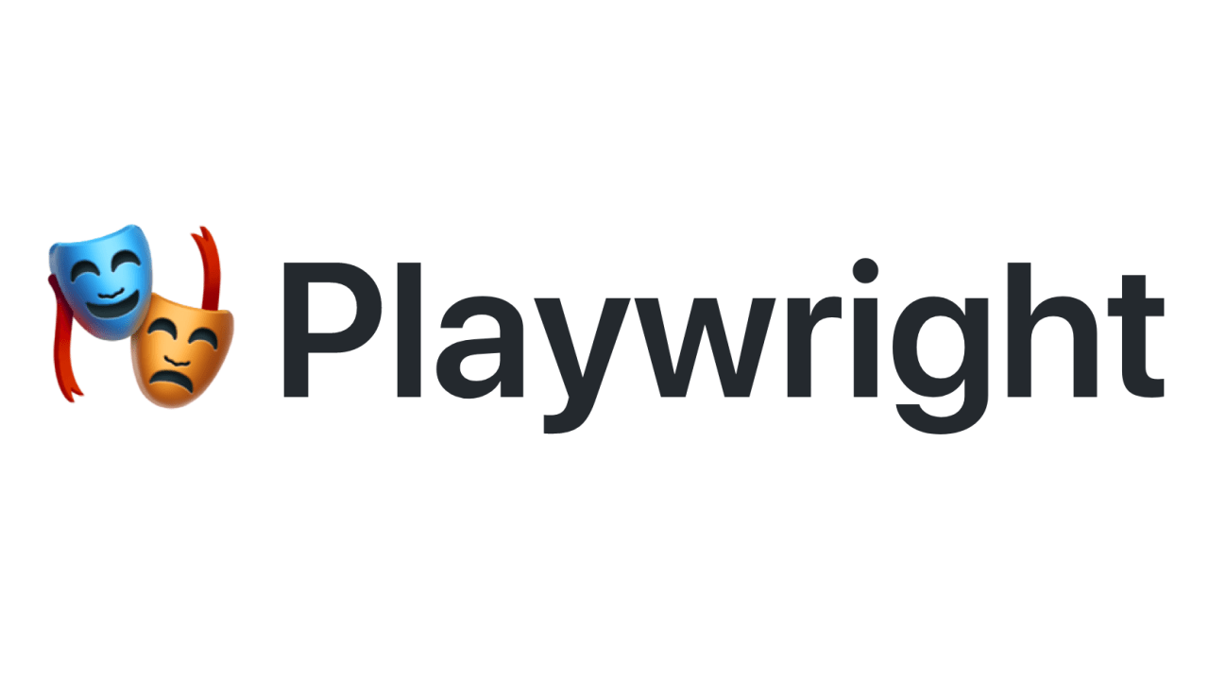
Learning PlayWright (Java)
E2E Web Testing with Playwright(Java)
Pramod Dutta
SDET Manager
Playwright Test Generator(Java) - Part 4

Slide 2
Agenda
Generate Test cases
Emulate devices
Emulate geolocation, language and timezone

Slide 3
Lets Learn
Generate Test cases for - https://app.vwo.com/free-trail/
mvn exec:java -e -Dexec.mainClass=com.microsoft.playwright.CLI -Dexec.args="codegen wikipedia.org"
https://playwright.dev/java/docs/codegen

Slide 4
Playwright Demo.

